Slide 1
Theater History of Operations (THOR): WWII
ANDREW PEREZ, BRENT MEULEBROECK, MICHAEL BADINGER, DANIEL TORRES, GARY JETER

Slide 2
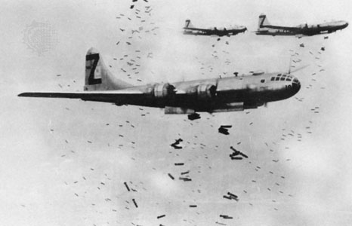
THOR Introduction
Theater History of Operations (THOR) is a collection of data regarding aerial bombings through several wars in the 20th century.
WWII data was selected in order to analyze bombings from the deadliest conflict in human history.

Slide 3
Data Extraction
The main dataset was extracted from data.world
This dataset consists of a main .csv file containing information about all the recorded missions (bombings) such as location, type of bomb, number of aircraft, date, etc.
One complimentary file provides additional details about the aircraft described in the main file. There was an additional weapons file however there was no field that could be used to match to it.
An additional dataset from Kaggle was included in the data extraction process. This time, the data provides details regarding weather conditions during WWII.
When both datasets are combined, it is possible to analyze how weather conditions might have affected the result of an aerial bombing.

Slide 4
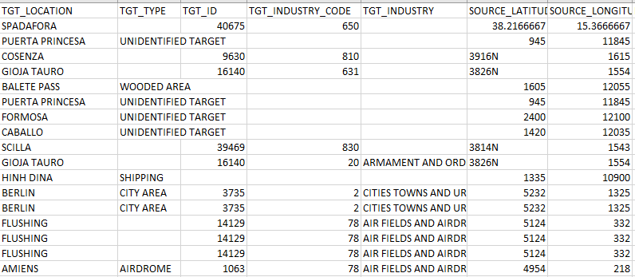
Data Snippet

Slide 5
Data Transformation
Since the data was recorded manually in the 1940's by many different military groups, a large portion of the information is missing.
At the same time, there are multiple categories that provide little to no information or are redundant, and therefore don't need to be included in the database.
Cleaning and combining datasets got rid of a large number of rows (from 170K to 25K)

Slide 6
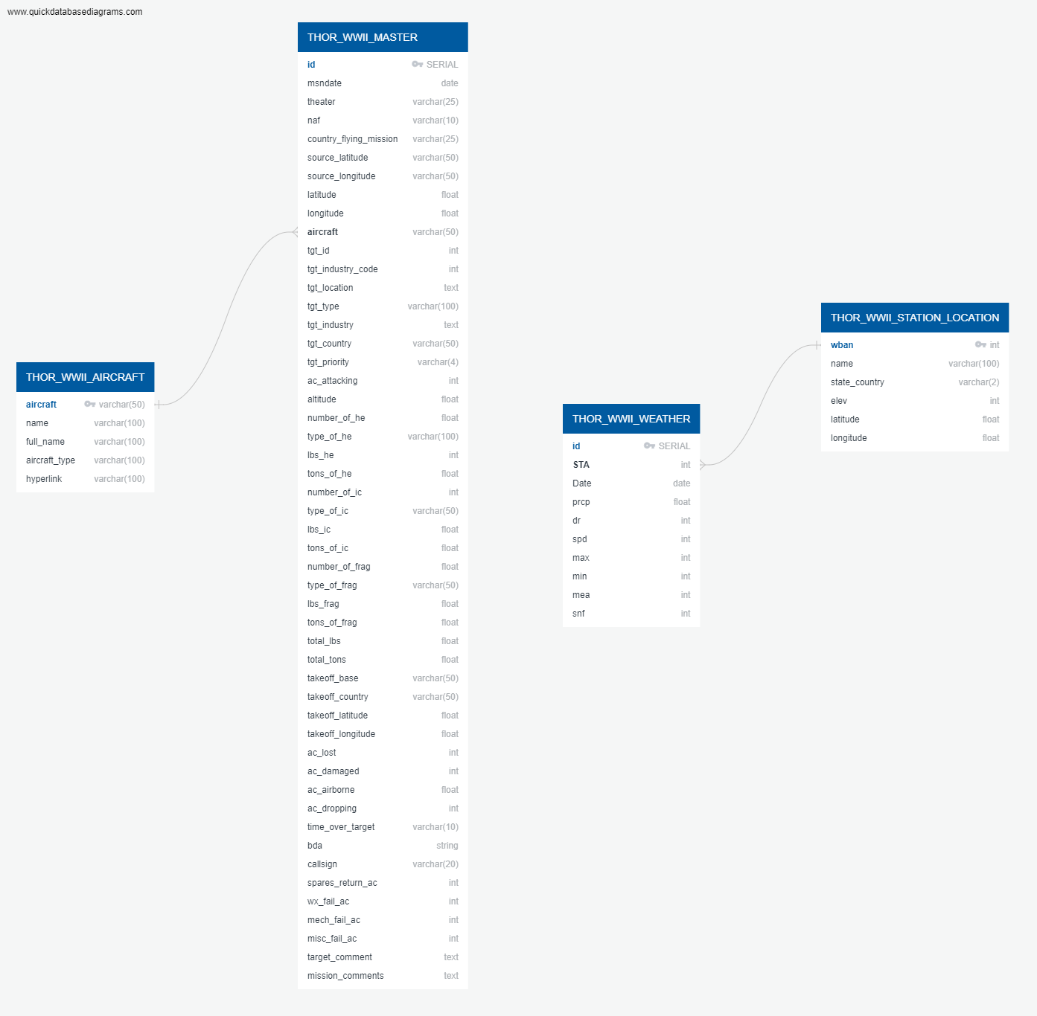
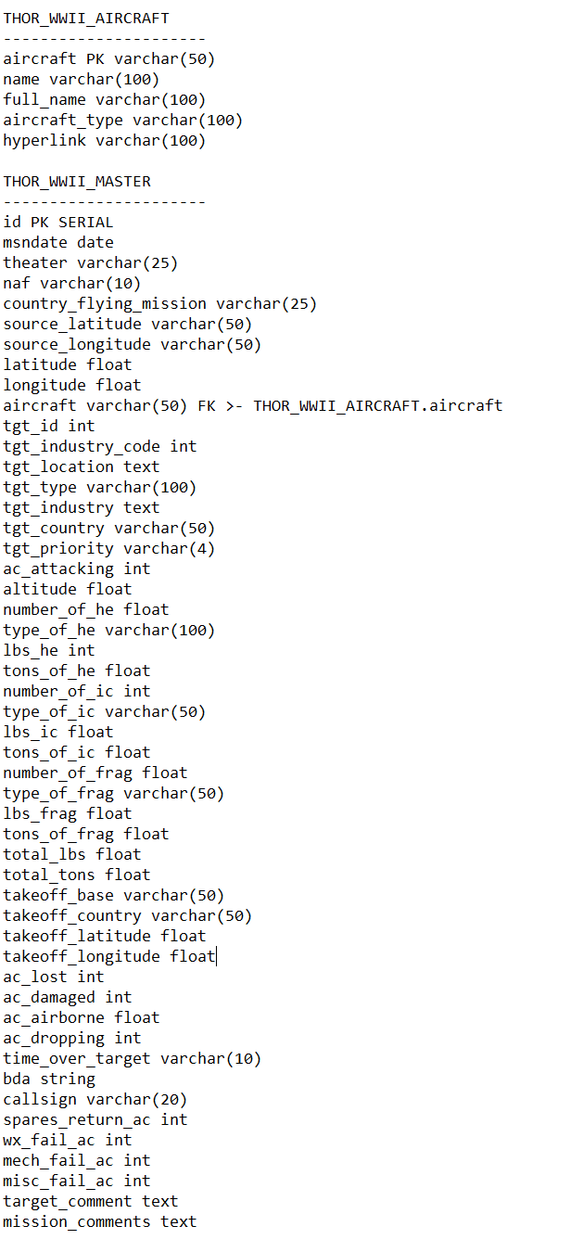
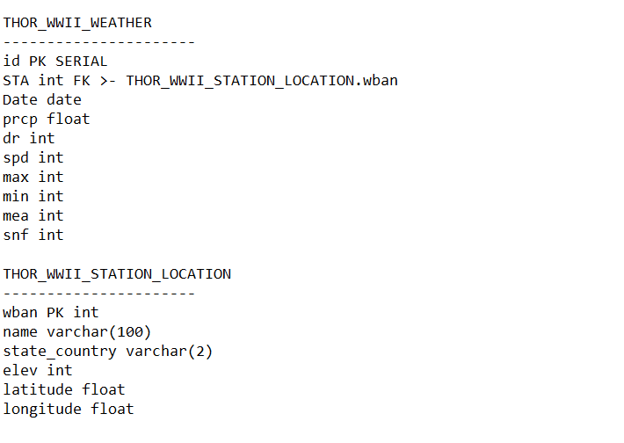
Schema

Slide 7
Demo

Slide 8
Future steps
There’s a lot of very interesting questions about WW2 bombing we could try to solve using the database we created.
In order to have a more complete database, we would need to find similar data from the Axis countries of WW2, or some other method of attack, such as ground army, naval fights, etc.
At the same time, we could add other datasets for different wars to understand how bombing changed through the 20th century.
Finally, we would like to look at different ways to combine data sets cleanly while keeping more data points.

Slide 9
Appendix

Slide 10
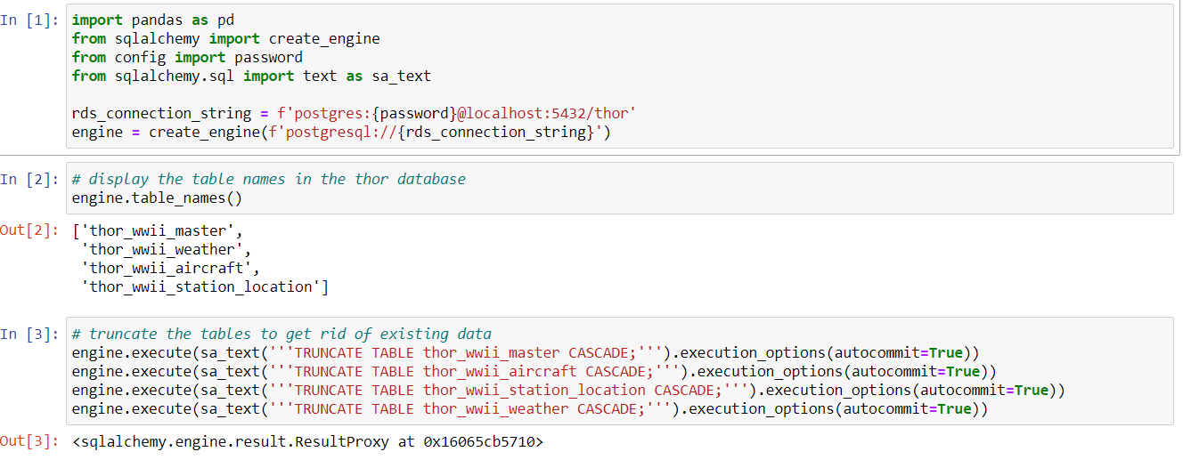
ETL
We start by loading the libraries, making a db connections, and truncating the tables.

Slide 11
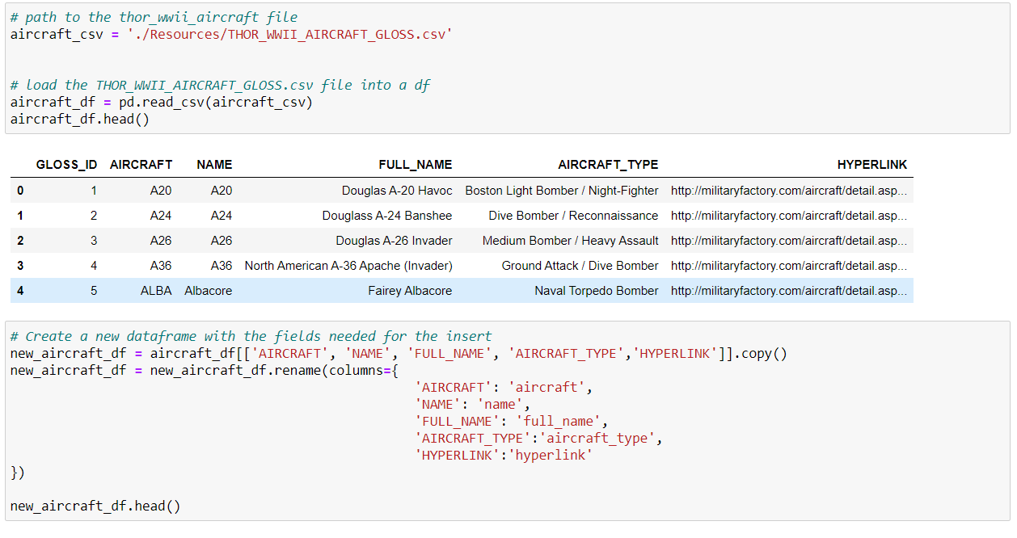
Extract and Transformation
Each table gets loaded
into a dataframe, and a new
dataframe is created with the
appropriate fields
selected and renamed to the
column names used in the tables.

Slide 12
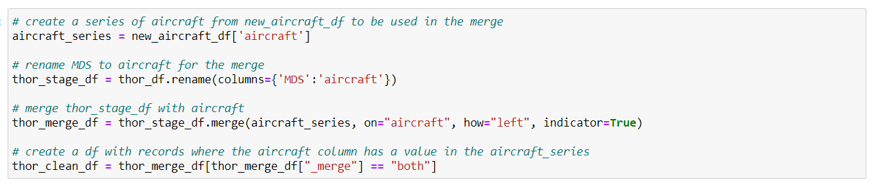
Transformation Continued
For the THOR_WWII_DATA_CLEAN.csv file we needed to drop the records that did not have a value in the THOR_WWII_AIRCRAFT_GLOSS.csv file due to a foreign key relationship.

Slide 13
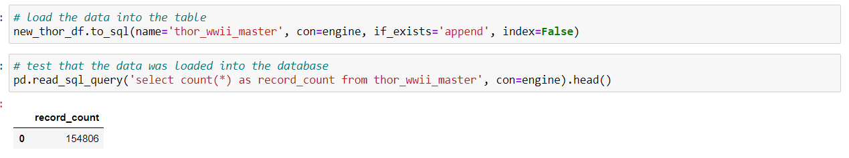
Loading the Data
Once the data is cleaned it gets inserted into the database and we return the count of the table that is was inserted into.

Slide 14
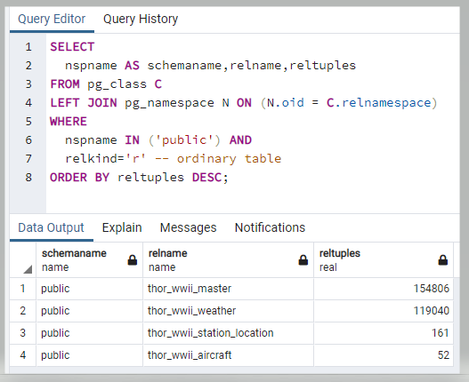
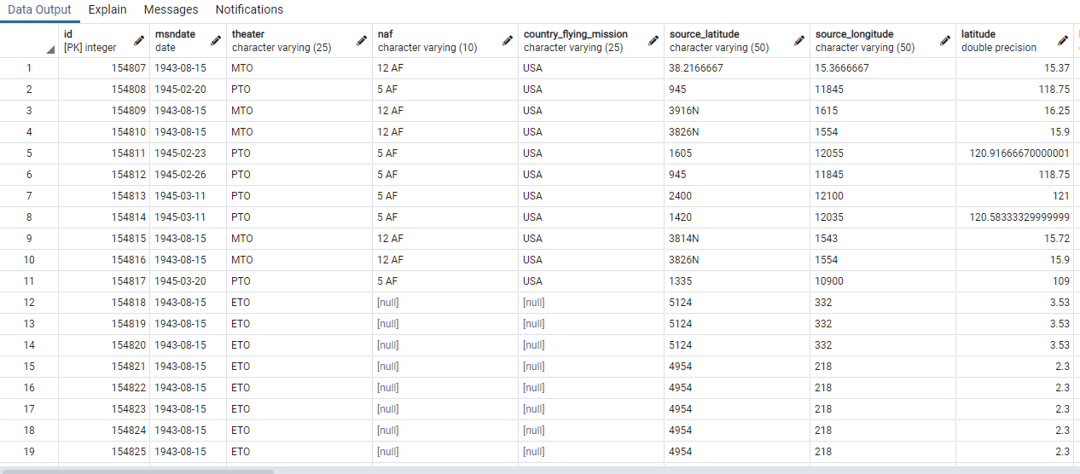
THOR Database tables

